Slide 1

Methods of Resource Scheduling Based on Optimized in Fog Computing
Presented by
Abdur Rashid Md. Emon Shaikh Roll No-1418018 Roll No-1418050

Slide 2
Contents
Introduction
Architecture of Fog Computing
Implementation of Fog Computing
Resource Scheduling
Propose of Scheduling Algorithm
FCFS, RR & Priority Scheduling Algorithm
Combination of FCFS, RR, PS Scheduling Algorithm

Slide 3
Introduction
Fog computing, also known as fogging/edge computing, it is a model in which data, processing and applications are concentrated in devices at the network edge rather than existing almost entirely in the cloud
The concentration means that data can be processed locally smart device rather than being sent to the cloud for processing.
The fogging (Fog Computing) is to improve efficiency and reduce the amount of data transported to the cloud for processing, analysis and storage. This is often done to improve efficiency, though it may also be used for security and compliance reasons.

Slide 4
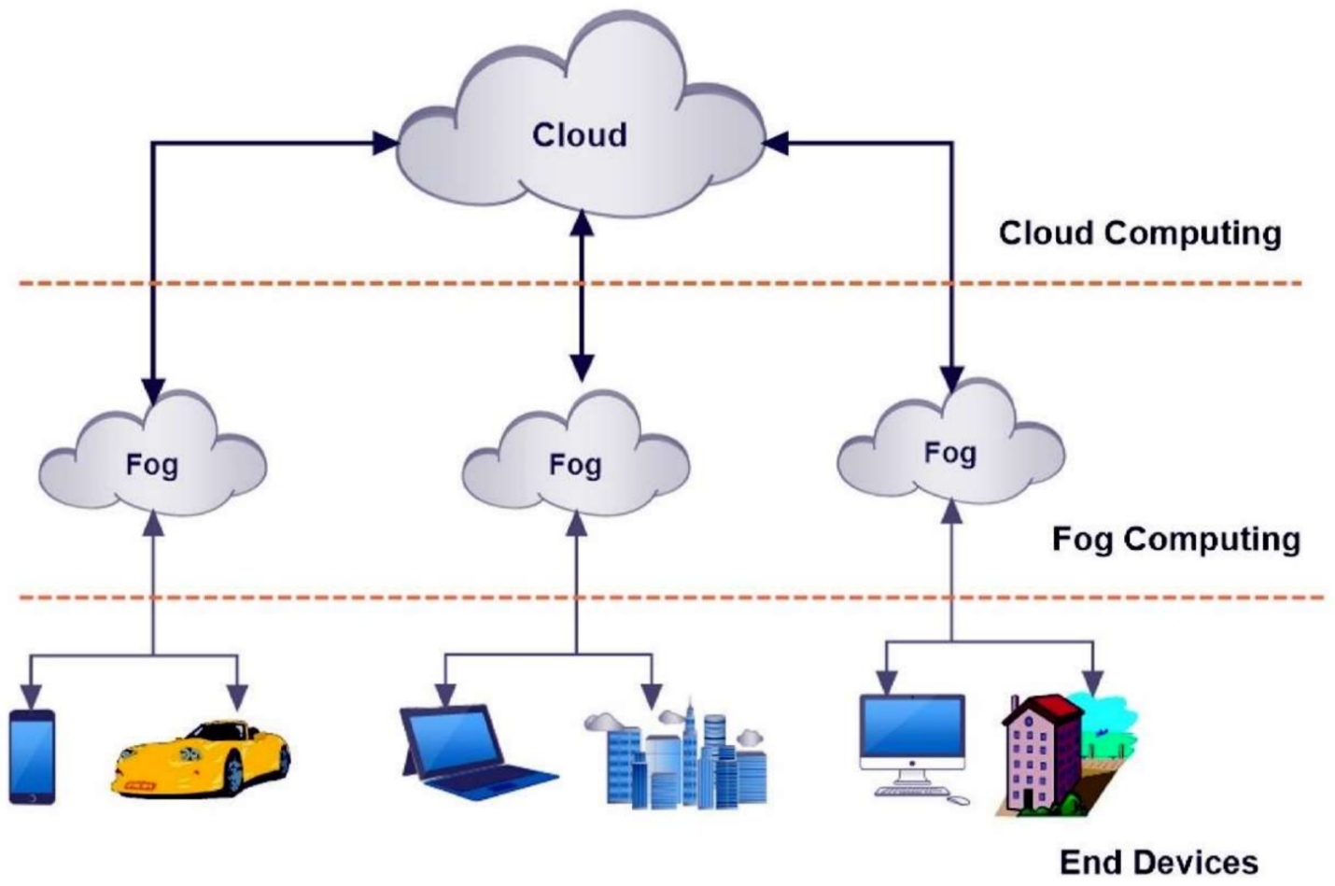
Architecture of Fog Computing

Slide 5
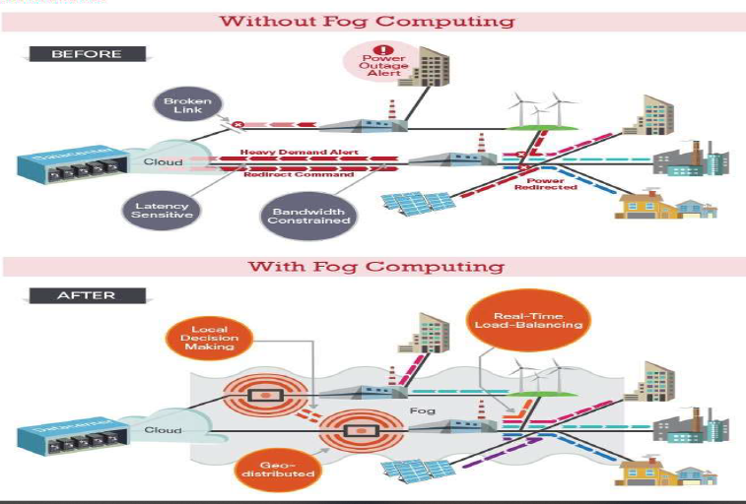
Implementation of Fog Computing

Slide 6
Resource Scheduling
Definition : Resource scheduling is a collection of techniques used to calculate the resources required to deliver the work and when they will be required.
The resource scheduling process has three steps:
Allocation : Allocation involves identifying what resources are needed to complete the work.
Aggregation : The aggregated data is usually presented in a histogram that illustrates the fluctuating use of resources against time.
Scheduling : Different types of scheduling we discuss that,

Slide 7
Propose Scheduling Algorithm
First Come First Served Scheduling Algorithm .
Round Robin Scheduling Algorithm.
Priority Scheduling Algorithm.

Slide 8
First Come First Served Scheduling
First in, first out (FIFO), also known as first come, first served (FCFS), is the simplest scheduling algorithm. FIFO simply queues processes in the order that they arrive in the ready queue.
In this, the process that comes first will be executed first and next process starts only after the previous gets fully executed.

Slide 9
FCFS Scheduling Algorithm Example
Process | Burst Time
P1 | 21
P2 | 3
P3 | 6
P4 | 2
The average waiting time will be =(0+21+3+6+2)/4=18.75 ms
This the GANT chart for the above process.
P1 | P2 | P3 | P4
0 21 | 24 | 30 | 31

Slide 10
Round Robin Scheduling Algorithm
Round Robin is a CPU scheduling algorithm where each process is assigned a fixed time slot in a cyclic way.
It is simple, easy to implement all processes get fair share of CPU.
One of the most commonly used technique in CPU scheduling as a core.
It is preemptive as processes are assigned CPU only for a fixed slice of time at most.
The disadvantage of it is more overhead of context switching.

Slide 11
Round Robin Scheduling Example
Suppose time quantum is 2 unit.
Process | Arrival time | Burst Time
P1 | 0 | 5
P2 | 2 | 1
P3 | 4 | 3
p1 | p2 | p1 | p3 | p1 | p3
0 2 3 5 7 9

Slide 12
Priority Scheduling Algorithm
Priority scheduling is one of the most common scheduling algorithms in batch systems. Each process is assigned a priority. Process with the highest priority is to be executed first and so on.
Processes with the same priority are executed on first come first served basis. Priority can be decided based on memory requirements, time requirements or any other resource requirement.

Slide 13
Priority Scheduling Algorithm Example
Process | Burst Time | Priority
P1 | 10 | 2
P2 | 5 | 0
P3 | 8 | 1
P2 | P3 | P1
0 5 | 13 | 23

Slide 14
Combination of FCFS, RR & Priority Scheduling Algorithm

Slide 15

Any Question ?

